Slide 1
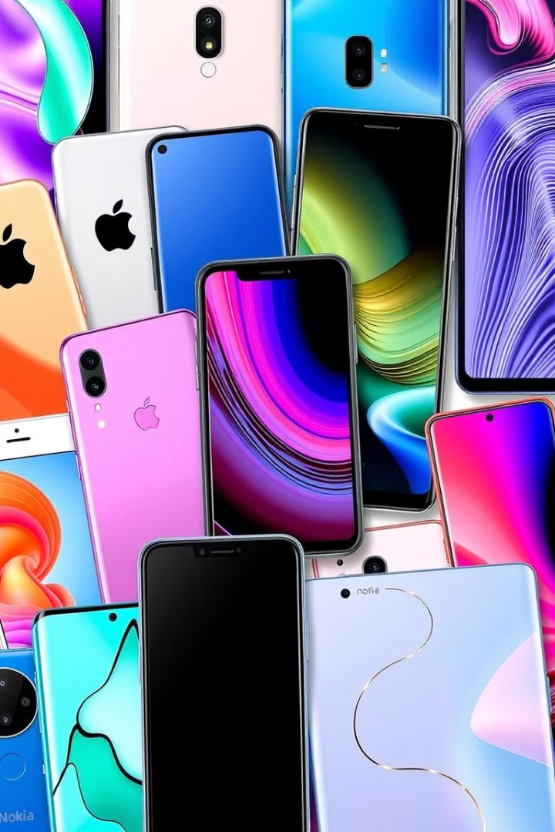

Feature Analysis & Price Prediction for Handsets
Understanding What Affects Mobile Prices and Predicting Them Accurately
In this project, I followed a step-by-step process to analyze and predict mobile prices. I began with data cleaning, where I resolved errors, handled missing values, and standardized the dataset. Then, I explored the data visually using Python libraries like Matplotlib and Seaborn to identify patterns and relationships. Key features like RAM, Processor, and Battery capacity were highlighted as significant factors affecting prices.
Next, I engineered new features to make the data more predictive and selected the most important ones for building models. Using Scikit-learn, I developed two models: a Linear Regression model as a baseline and a Random Forest Regressor to handle complex relationships. To improve model accuracy, I used GridSearchCV for hyperparameter tuning.
Finally, I evaluated the models using metrics like R-squared and Mean Absolute Error (MAE), identifying the Random Forest model as the most accurate. This systematic approach integrated Data Cleaning, Visualization, Feature Selection, Model Building, and Tuning to understand mobile pricing dynamics and predict prices effectively.
by Debasis Baidya

Slide 2





Importing of the necessary Libraries & Modules
Numpy
It helped with mathematical operations, allowing me to compute statistics and handle missing values efficiently.
Pandas
To load & organize the datasets, making it easy to explore the data structure and perform operations like merging and filtering.
Matplotlib
Used it to create visualizations, such as bar charts and histograms, to better understand the data distributions and trends.
Seaborn
For generating more advanced visualizations, helping me check for skewness & visualize correlations between different variables.
Scikit-learn (Sklearn)
For preprocessing the data, specifically using the SimpleImputer to fill in missing values and to identify and manage outliers effectively.

Slide 3
Mobile Phone Price Prediction: A Comprehensive Analysis
Data Exploration
1
1. Dataset Size: 541 rows and 12 columns
Missing Values: None
2. Numerical Features: Memory, RAM, Battery_, Prize
Categorical Features: Model, Brand, Colour Family, Rear Camera, Front Camera, Processor_
2
Data Preprocessing
1. Identified 187 distinct models and 275 colours.
2. Conducted a Univariate Analysis of memory, RAM, battery, height, and price.
3. Performed a Multivariate Analysis to explore correlations between features such as memory and RAM, battery and mobile height, and AI lens and price.
Feature Analysis and Extraction
3
Unique Brands: Extracted distinct brands from the models.
Colour Normalization: Extracted & standardized colour names into categories.
Feature Identification: Extracted categorical and numerical features.
Outlier Detection and Handling: Extracted outliers using the IQR method and capped them to improve quality.
Data Encoding: Extracted and applied One-Hot and Label Encoding for analysis.
4
Model Training, Feature Scaling | PCA
Data Preparation: Extracted features (X) and target (y); split data into 80/20 training/testing sets.
Feature Scaling: Standardized features using StandardScaler.
Dimensionality Reduction: Reduced to 10 components with PCA.
Model Training: Trained models: Linear Regression, Decision Tree, Random Forest.
Performance Evaluation: Metrics: MAE, RMSE, R² Score.
Model Performance, Predict | Compare
5
Model Saving: Saved Random Forest as `handset_price_model.pkl`.
Performance: Evaluated models (MAE, RMSE, R²).
Loading: Loaded model using joblib.
Data Prep: Selected 5 entries, scaled, and transformed.
Predictions: Predicted target variable (Prize).
Comparison: Actual vs predicted values; calculated differences.
Visualization: Scatter plot with perfect prediction line.
6
Improving Predictions &Tuning with XGBoost
Model Usage: The XGBoost Regressor was used for effective value prediction.
Parameter Tuning: Optimized the model's settings for better performance.
Optimization Process: GridSearchCV helped us find the best hyperparameter combinations.
Model Training: The model learned from the data to improve its predictions.
Optimal Parameters: Key settings included a learning rate of 0.1, max depth of 5, 200 trees, and a subsample rate of 1.0.
Prediction Results: It achieved a Mean Absolute Error (MAE) of 36.78, indicating strong accuracy.
New Data Testing: The model also performed well on new data, showing it can generalize effectively.
Feature Importance Analysis
7
Feature Importance Analysis: Feature importance extraction was used to identify key predictors.
Model Usage: The best predictive model was utilized for feature importance analysis.
Parameter Analysis: Feature importance were extracted and sorted by importance score.
Key Findings: "Prize" of product emerged as the most important feature, followed by front and rear camera specs followed by front and rear camera specs
Feature Ranking: Top 10 most important features were identified, providing insights into key prediction drivers.

Slide 4





Data Exploration Summary
Loading the Data
Inspecting Dataset
Missing Values
Categorical
Columns
Numerical
Columns
Missing Values & Dataset Size
Identifying Categorical Columns
Identifying Categorical Columns
Importing of Libraries & Loading the Data
Inspecting Dataset & Statistics Summary
Check for Missing Values: Used data.isnull().sum() to inspect for any missing entries in the dataset.
Dataset Size: 541 rows and 12 columns
Missing Values: None
Identified Columns: Extracted categorical columns using data.select_dtypes(include=['object’])
Categorical Features Found: Model, Brand, Colour Family, Rear Camera, Front Camera, Processor_
Identified Columns: Extracted numerical columns with data.select_dtypes(include=['int64', 'float64'])
Numerical Features Found: Memory, RAM, Battery_, Prize
First Few Rows: Displayed the initial rows using data.head()
DataFrame Info: Used data.info() to check the structure and data types.
Summary Statistics: Generated descriptive statistics with data.describe() to analyze distributions.
Libraries Used: Utilized Pandas and NumPy for data manipulation.
Data Source: Loaded the dataset from an Excel file located on the local drive.

Slide 5
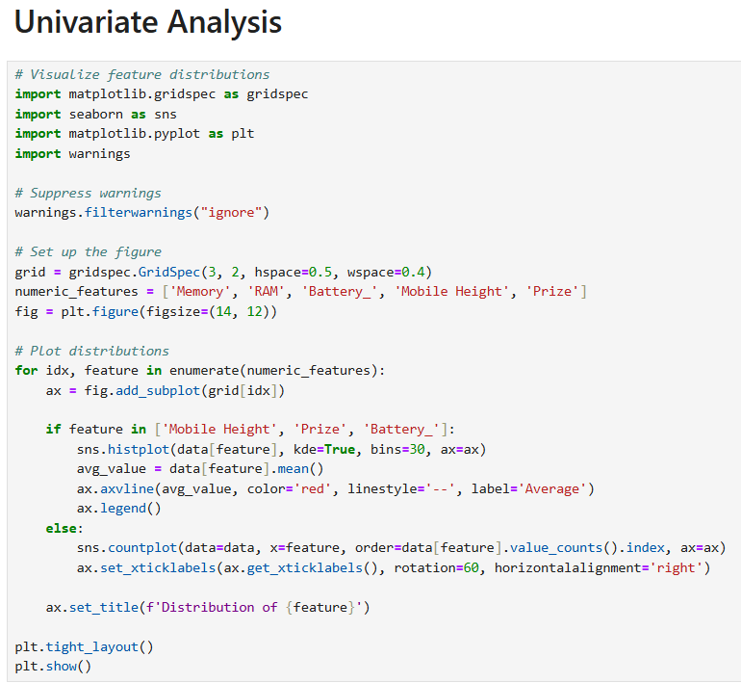
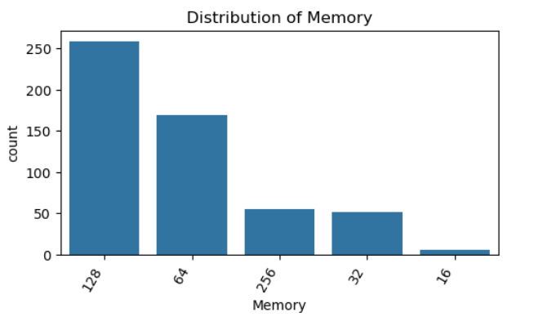
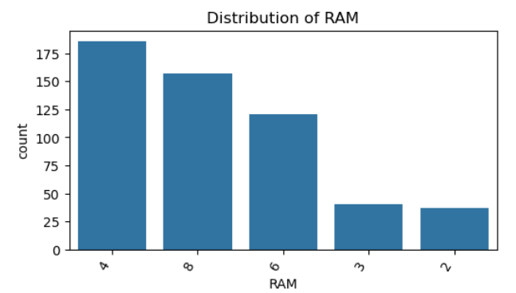
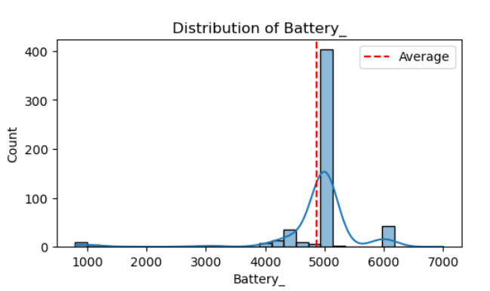
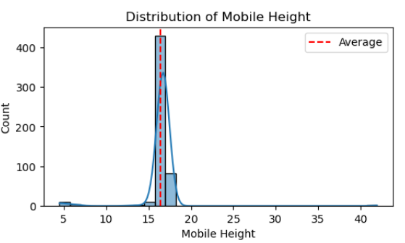
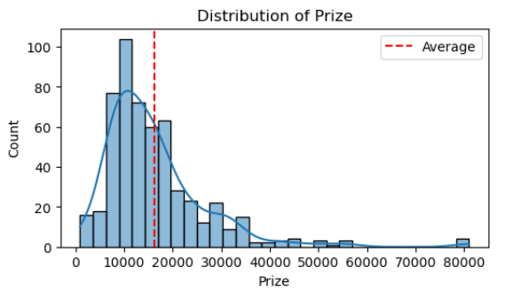
Data Preprocessing
Univariate Analysis
1
Memory and RAM
2
Battery Capacity
Most devices have 128GB or 64GB of memory and 4GB or 8GB of RAM.
The majority of phones have batteries around 5000mAh.
3
Mobile Height
4
Price Distribution
Most devices fall within the 15-17 units Height Range.
Most phones cost less than or equal to ₹20,000.00.

Slide 6
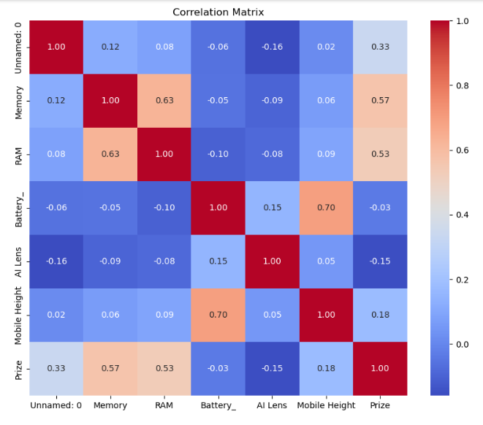
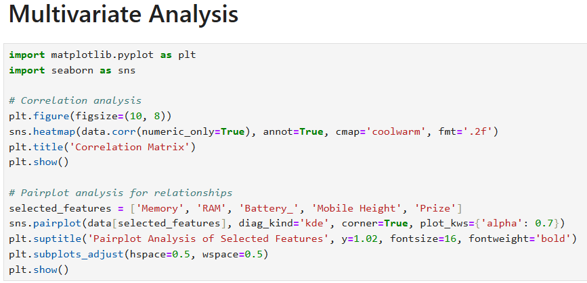
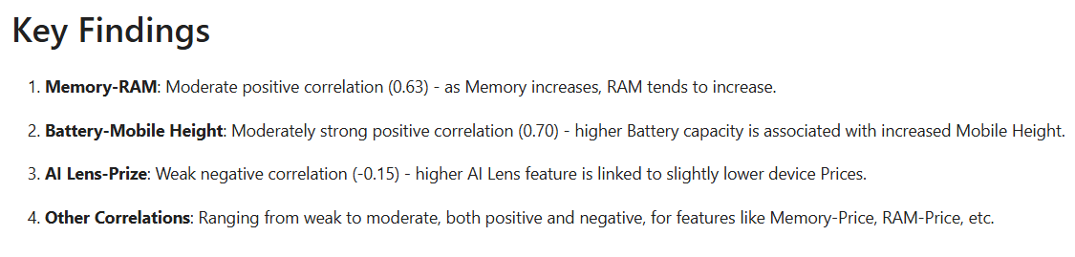
Data Preprocessing
Multivariate Analysis

Slide 7
Feature Analysis and Extraction
Feature Extraction: Brand Extraction from Models
1
1 | Normalization
Converted model names to lowercase for case-insensitive comparison.
2
Normalization
2 | Brand Extraction
Brand Extraction
Extracted brand names by taking the first word from the normalized model names.
3
Rectification
3 | Rectification
Corrected improperly extracted brands by replacing:
- 'I' with 'I Kall'
- 'Micromax1' with 'Micromax'
4
Initial Unique Brands
4 | Initial Unique Brands
5
Final Unique Brands
A preliminary list of unique brands was generated:
['Infinix' 'Motorola' 'Poco' 'Redmi' 'Samsung' 'Vivo' 'Realme' 'Micromax'
'Google' 'Micromax1' 'Oppo' 'Tecno' 'Nothing' 'I' 'Itel' 'Oneplus' 'Iqoo'
'Nokia' 'Apple' 'Lava']
5 | Final Unique Brands
After rectification, the unique brands identified include:
['Infinix' 'Motorola' 'Poco' 'Redmi' 'Samsung' 'Vivo' 'Realme' 'Micromax'
'Google' 'Oppo' 'Tecno' 'Nothing' 'I Kall' 'Itel' 'Oneplus' 'Iqoo'
'Nokia' 'Apple' 'Lava']

Slide 8
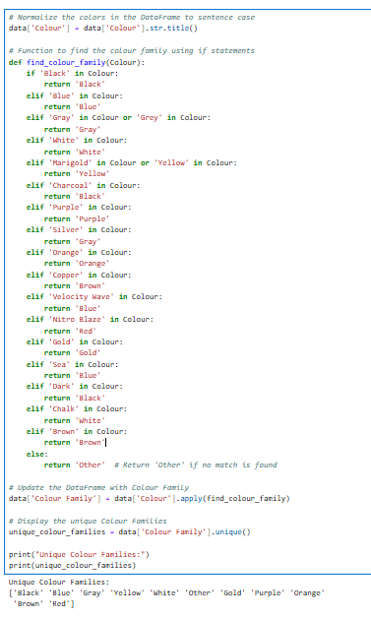
Feature Analysis and Extraction
Feature Extraction: Colour Families Extraction from Colours
1
Normalization
Converted colours to sentence case using the
str.title() method
2
Color Family Classification
Defined a function to categorize colours based
on keywords
3
DataFrame Update
Applied the function to create a new column for
Colour Families
Unique Color Families Extraction
4
Extracted unique colour families from the updated DataFrame: Unique Colour Families:
['Black’ ,'Blue’, 'Gray’, 'Yellow’, 'White’, 'Other’, 'Gold’, 'Purple’, 'Orange’, 'Brown’, 'Red']

Slide 9

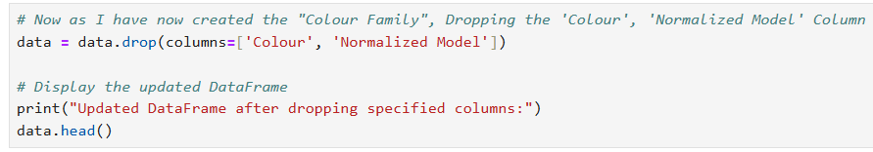

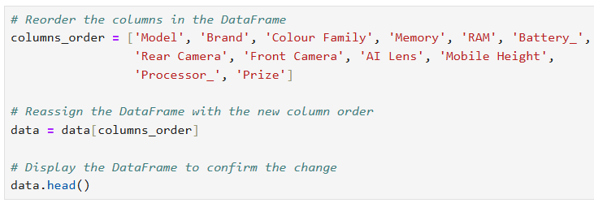

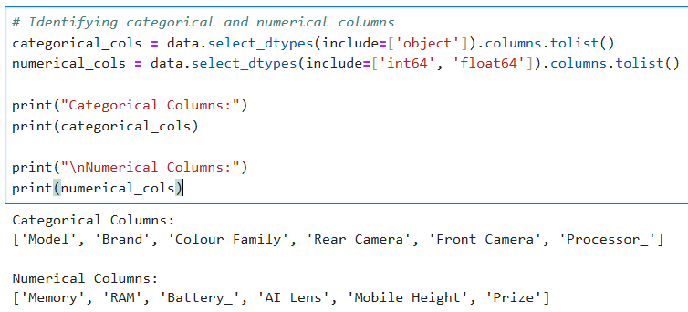

Data Preprocessing
Things I did before Outlier Handling
Reordered Columns
Specified the new column order and reassigned the
DataFrame to this new order
Dropped Unnecessary Columns
Removed the 'Colour' and 'Normalized Model' columns from
the DataFrame as we now have 'Brand' & 'Colour Family’.
The DataFrame now contains the columns in the desired order,
excluding 'Colour' and 'Normalized Model'
Re-Identified Categorical & Numerical Columns
Categorical Columns:
['Model', 'Brand', 'Colour Family', 'Rear Camera', 'Front Camera', 'Processor_']
Numerical Columns:
['Memory', 'RAM', 'Battery_', 'AI Lens', 'Mobile Height', 'Prize']

Slide 10
Outliers Detection | Handling | One Hot & Label Encoding
One-Hot Encoding
Applied One-Hot Encoding to nominal categorical columns (*Model, **Brand, **Processor_, **Colour Family*) using pd.get_dummies(), excluding the first category to avoid dummy variable trap.
IQR Calculation
Calculated the first quartile (Q1) and third quartile (Q3) for the specified column to determine the IQR
Count of Outliers
Generated a count of outliers for each numerical feature using the defined function
Outlier Identification Function
Defined a function identify_outliers_iqr to calculate outliers based on the Interquartile Range (IQR)
Outlier Bounds
Established lower and upper bounds:
- Lower bound = Q1 - 1.5 * IQR
- Upper bound = Q3 + 1.5 * IQR
Capping Outliers
Used the clip method to cap values outside the bounds for each numerical feature
Label Encoding
Used LabelEncoder to encode ordinal categorical columns (*Rear Camera, **Front Camera*) into numerical values

Slide 11
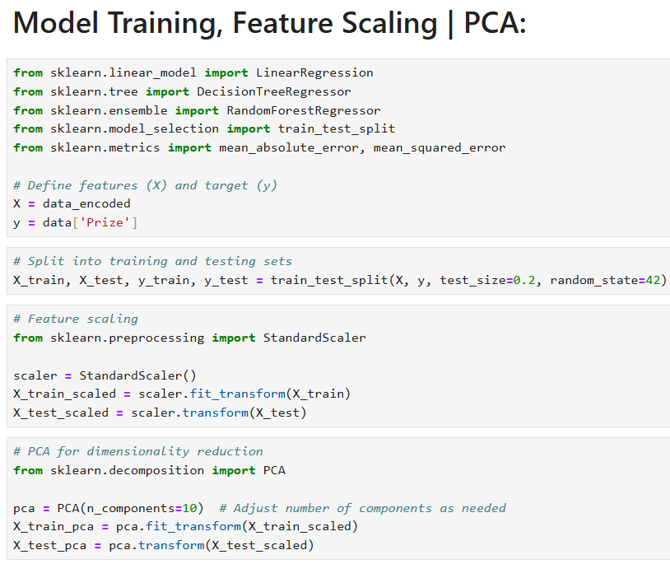



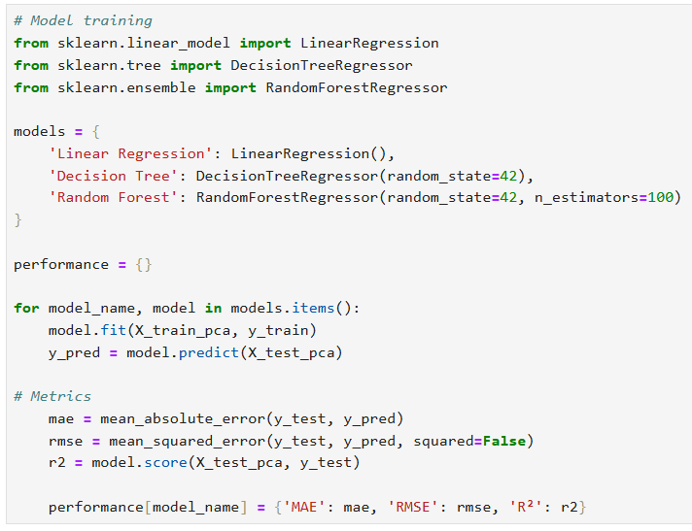


Model Building: Model Training, Feature Scaling | PCA
Data Preparation
- Defined features (X) and target variable (y) from the dataset.
- Split the data into training and testing sets with an 80/20 ratio,
using 80% for training and 20% for testing.
Feature Scaling
Applied *StandardScaler* to standardize the features, ensuring
they have a mean of 0 and a standard deviation of 1.
Dimensionality Reduction
- Utilized Principal Component Analysis (PCA) to reduce the feature
set to 10 components, retaining the most significant variance in the
Data.
Model Training
- Trained three regression models:
- Linear Regression
- Decision Tree Regressor
- Random Forest Regressor with 100 estimators.
Performance Evaluation
- Evaluated each model's performance using:
- Mean Absolute Error (MAE)
- Root Mean Squared Error (RMSE)
- R² Score

Slide 12
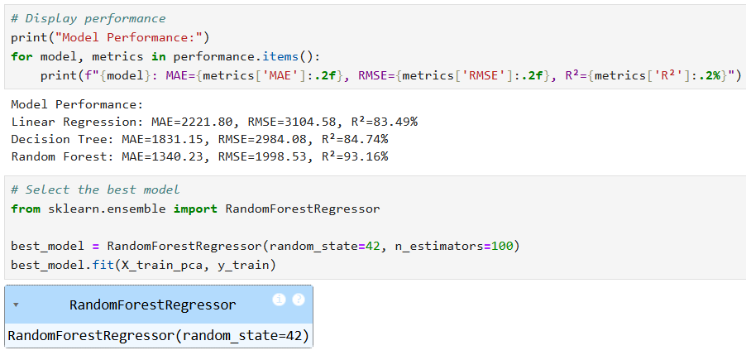
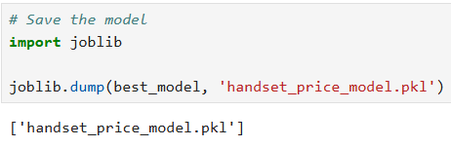
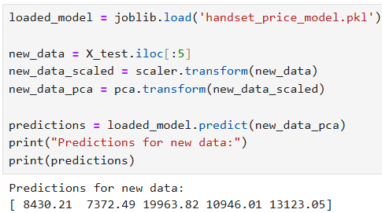
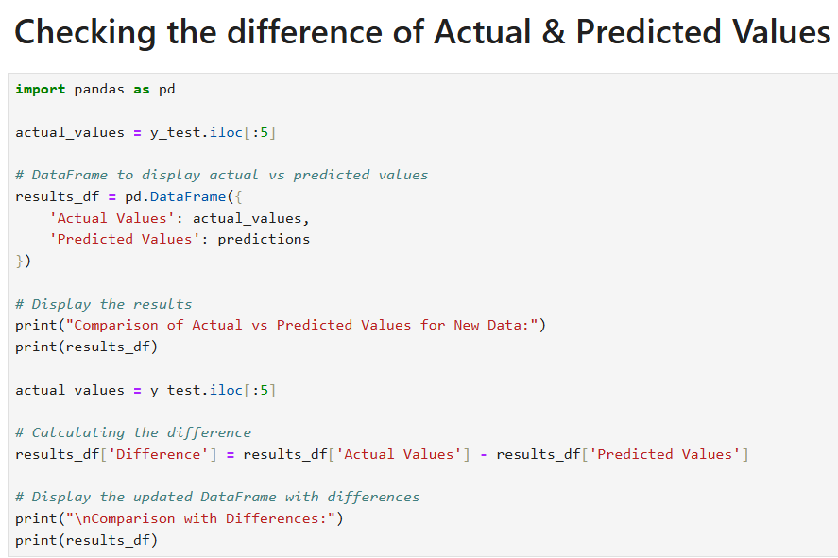
Model Evaluation: Model Performance,
Best Model Selection & Saving the Model
1
Model Saving
The best-performing model, identified as the Random Forest Regressor, was saved using
the joblib library. The model is stored as “handset_price_model.pkl” for future use.
2
Model Performance
Displayed the performance metrics for each model:
1. Linear Regression | 2. Decision Tree | 3. Random Forest.
Outcome
3
The Random Forest Regressor emerged as the best model based on the performance
metrics, particularly excelling in R² score, indicating it explains a significant portion of the
variance in the target variable (Prize).
4
Model Loading
The saved model (handset_price_model.pkl) was loaded using the joblib library.
Data Preparation for Predictions
5
Selected the first 5 entries from the test dataset (X_test) for making predictions.
Scaled the new data using the previously fitted *StandardScaler*.
Transformed the scaled data using *PCA* to match the model's input requirements.
6
Predictions
The loaded model was used to predict the target variable (Prize) for the prepared new data.
Predictions were printed, providing the estimated values for the selected entries.
7
Actual vs Predicted Values
A DataFrame was created to compare the actual values from the test set with the predicted
values obtained from the loaded model for the first 5 entries.
8
Calculating Differences
A new column was added to the DataFrame to calculate the difference between the actual
and predicted values.

Slide 13
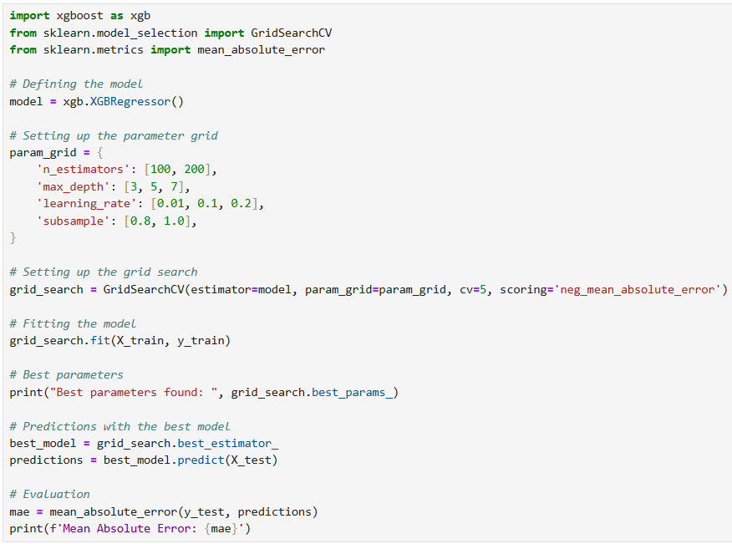
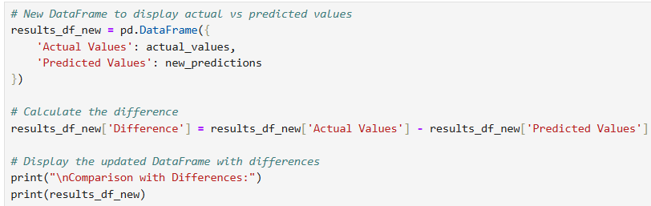
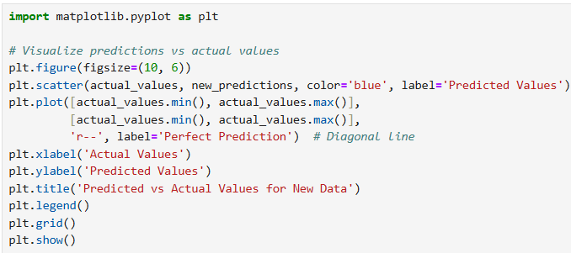
Improving Predictions with
Hyperparameter Tuning in XGBoost
The model's predictions are plotted against the actual values to evaluate the performance
Defined
XGBoost Regressor model
08
01
Parameter Grid creation for Hyperparameter Tuning
Comparison of Actual vs Predicted Values
07
02
Improving Predictions with XGBoost
06
03
Grid Search Configuration with GridSearchCV
Cross-validation & Scoring Metric
The tuning process successfully identified optimal hyperparameters
05
04
The best model was used to make predictions on the test set (X_test)
Model Fitting on the training data (X_train, y_train) to find the optimal parameters

Slide 14
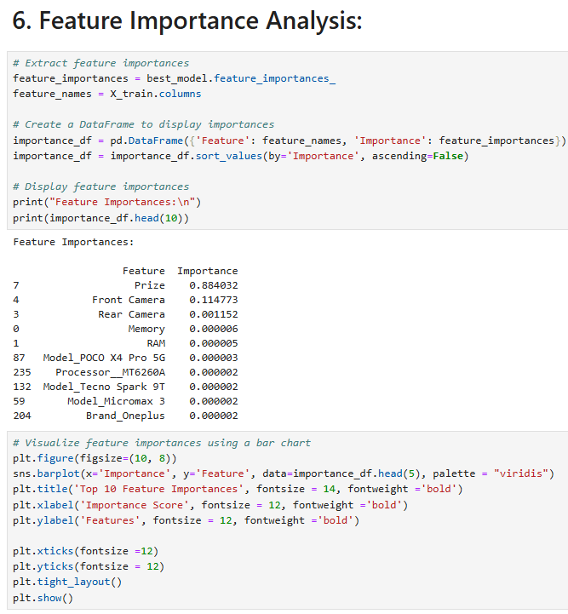
Feature Important Analysis
Most Important Feature
The "Prize" of the product is identified as the most important feature, exhibiting a high importance score that significantly influences model predictions.
Relatively Important Features
The specifications of the front and rear cameras are also important, contributing meaningfully to the model's accuracy and predictions.
Less Important Features
Other features in the dataset have much lower importance scores, indicating they contribute less to the overall predictions of the model.
Feature Extraction
The feature importances were derived from the best predictive model utilized in the analysis.
Organization
The features along with their importance scores were compiled into a table and sorted from highest to lowest importance for clarity.

Slide 15





Summary
Future Enhancements
Q&A
This project developed a mobile handset price prediction model using data exploration, feature extraction (Brand & Colour), preprocessing (One-Hot & Label Encoding, IQR Handling), & Model Building with Random Forest and XGBoost. Key predictors included Memory, RAM, Battery, and Brand. Challenges with high cardinality features and outliers were addressed, resulting in a strong predictive model.
To improve the model by adding more features. Tune the settings for better accuracy. Using multiple models can enhance predictions. Checking performance will ensure reliability. Tools can help explain predictions. A real-time system would be useful. Gathering feedback will aid in improvements.
The presentation is open for any questions & suggestions from the reviewer.

